Slide 1
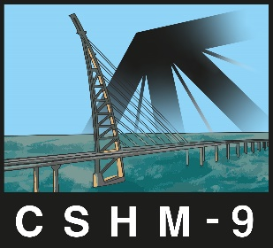
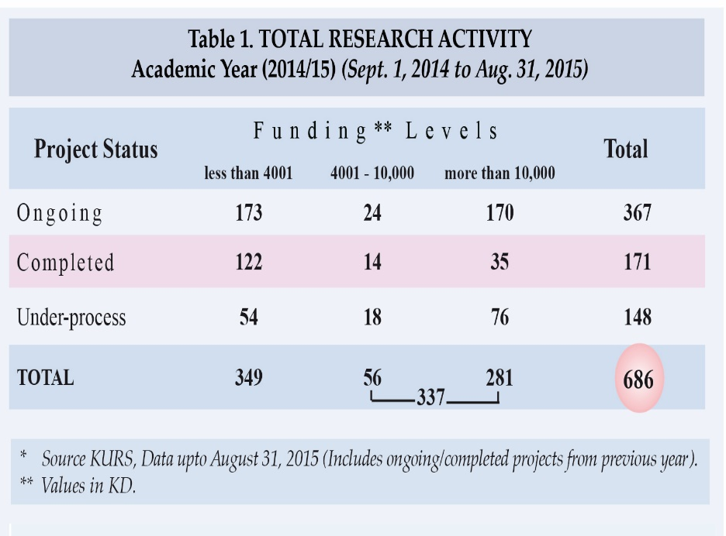
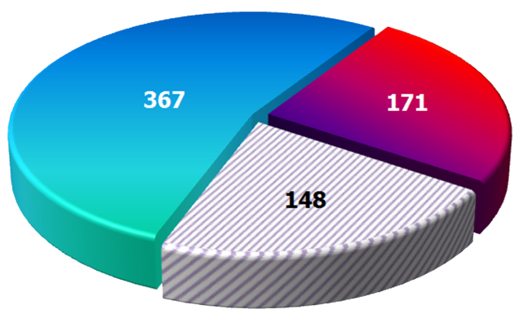

The 9th International Workshop on Civil Structural Health Monitoring (CSHM-9)
Kuwait, 12-14 Feb. 2024
Title of Research Study(Arial Bold 60-72 )
Researcher(s)/Author(s)Name(s)(Arial Bold 32-36)
Department / Faculty (Arial Bold 28-32)
Abstract (Arial 28-32)
Oral cancer, widely prevalent in developed and developing world, is also linked to demographics as age, gender and ethnicity. It is an important public health issue with its widely prevalent in developed and …………….. (Text in Arial 20)
Results (Arial Bold 40-44)
Oral cancer, widely prevalent in developed and developing world, is also linked to demographics as age, gender and ethnicity. It is an important public health issue with widely (Text in Arial 20-24)
Introduction (Arial Bold 40-44)
Oral cancer, widely prevalent in developed and developing and developing world (Text in Arial 20-24)
Objectives
Oral cancer, widely prevalent (Text in Arial 20-24)
Conclusion (Arial Bold 40-44)
Oral cancer, widely prevalent in developed (Text in Arial 20-24)
Methods (Arial bold 40-44)
Oral cancer, widely prevalent in developed and developing and developing world, is also linked to demographics as age, gender and (Text in Arial 20-24)
References (Arial 24-28)
Acknowledgements (Arial 24-28)
Researchers Contact details

